Slide 1

AN
AUTOMATED
INVIGILATION
SYSTEM
Batch -18
P.Naveen reddy - 23n35A1214
R.Srihari - 23n35a1215
t.Siddharth reddy - 22n31a12h8

Slide 2
Agenda
INTRODUCTION
EXISTING SYSTEM
PROPOSED SYSTEM
SYSTEM REQUIREMENTS
APPLICATION DESCRIPTION
RESULTS
CONCLUSION
REFERENCES

Slide 3
Introduction
In an era where efficiency and accuracy are more crucial than ever, scheduling and coordinating exam invigilation can be both complex and labor-intensive. Institutions often struggle with challenges such as coordinating schedules, managing human resources, and ensuring adequate coverage for all exam sessions. These tasks are not only time-consuming but can also lead to inefficiencies and potential errors. Our Automated Invigilation Scheduler is designed to address these challenges by automating the scheduling process, optimizing resource allocation, and streamlining the management of invigilation duties.

Slide 4
Existing system
A manual system for scheduling exam invigilation presents several challenges, including time-consuming processes, increased human error, and inefficient resource allocation. Additionally, manual systems provide limited reporting and analytics, making it difficult to assess efficiency and adapt to schedule changes. This inflexibility can result in poor coverage assurance and increased stress for administrative staff, ultimately impacting the integrity of the examination process. An Automated Invigilation Scheduler can effectively address these issues, enhancing overall efficiency and reliability.

Slide 5
Proposed system
The proposed system for an automated invigilation scheduler system is a comprehensive solution designed to optimize the process of assigning invigilators to examination halls and schedules. The system consists of four main components: the Invigilator Module, Venue Module, student module, and Scheduling Engine. The Invigilator Module manages invigilator profiles, availability, and workload, while the Venue Module manages venue properties, and capacity. The Student Module manages student profiles, requirements, and exam schedules. The Scheduling Engine is the core component that automatically generates schedules based on constraints and preferences.

Slide 6
REQUIREMENTS
SOFTWARE REQUIREMENTS
IDE - VS CODE
FRONT END - HTML,CSS,JS
BACK END - JAVA,MySQL
HARDWARE REQUIREMENTS
RAM - 512 MB AND ABOVE
HARD DISK - 8 GB AND ABOVE
PROCESSOR - INTEL

Slide 7
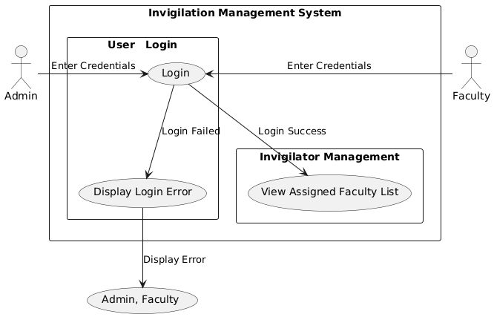
Application description
SYSTEM ARCHITECTURE

Slide 8
modules
There are mainly three modules present in an automated invigilation system which includes :
Main module
User login module
Invigilator management module

Slide 9
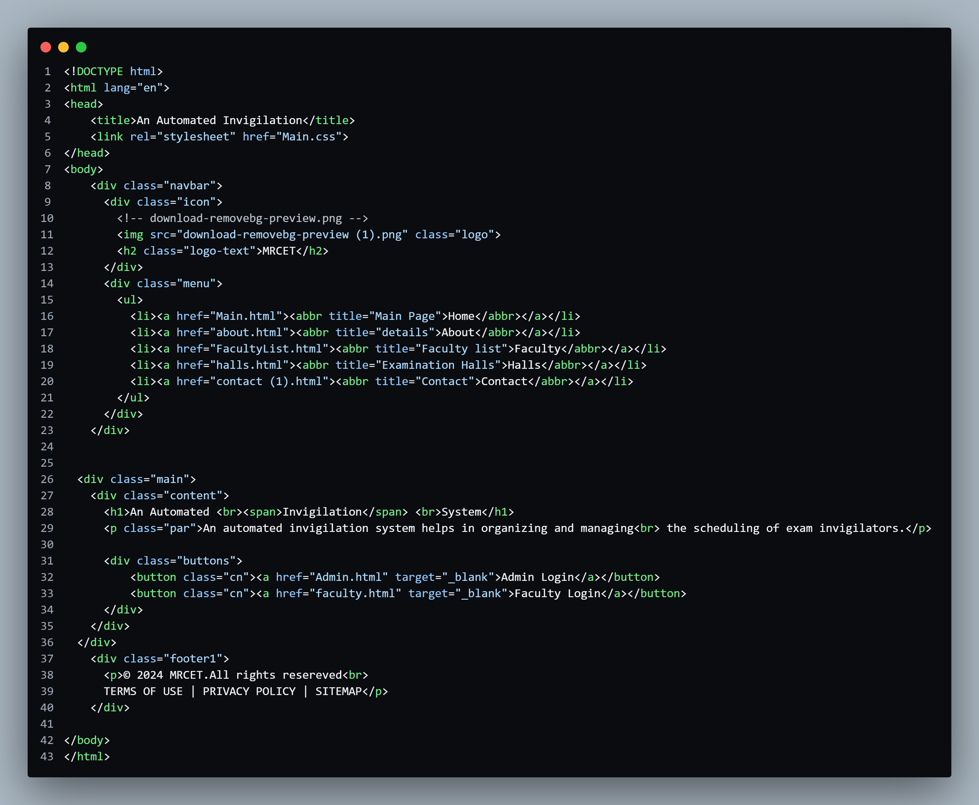
code

Slide 10
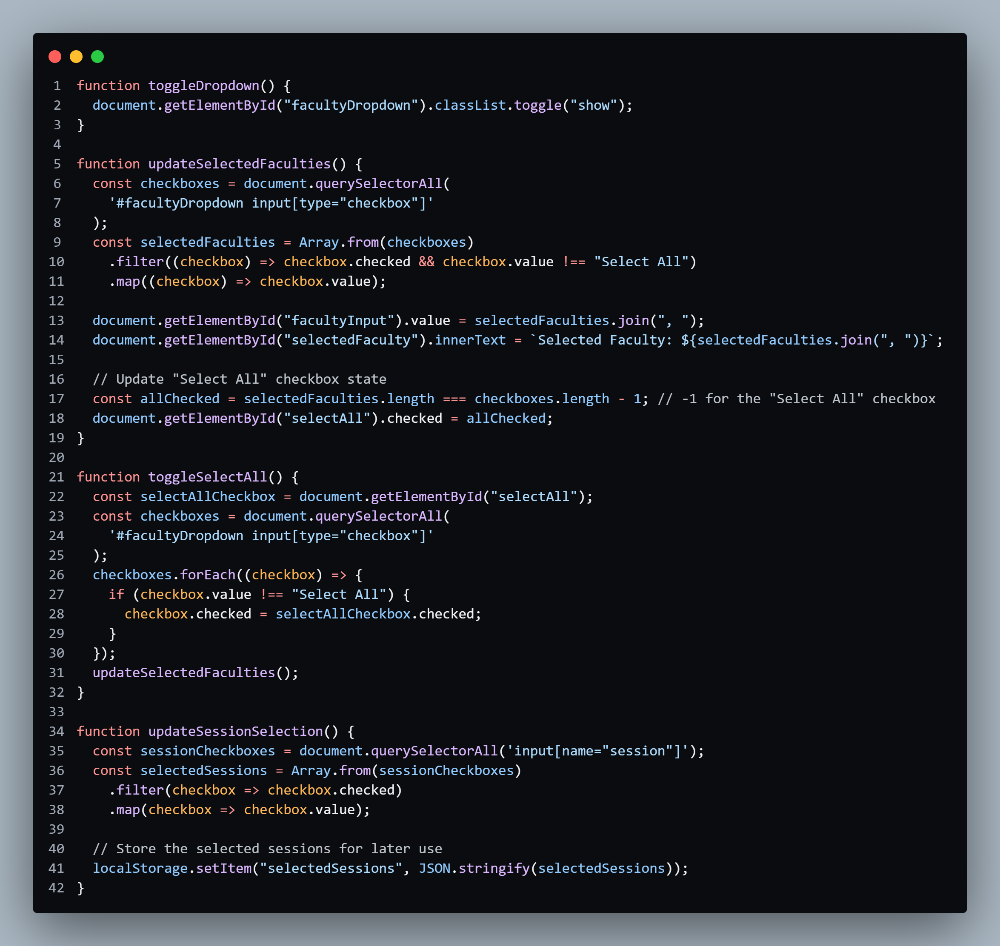
.

Slide 11
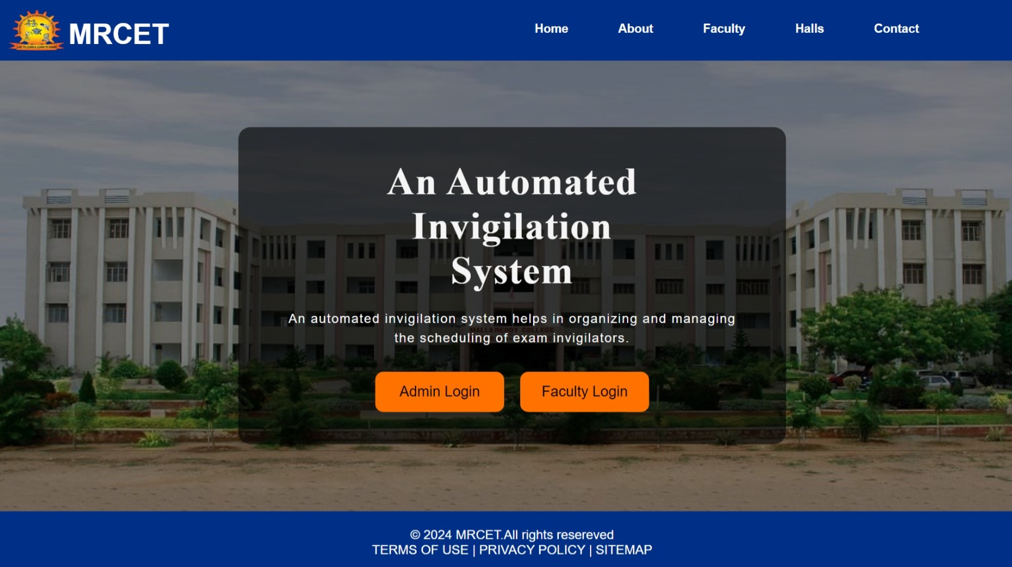
results

Slide 12
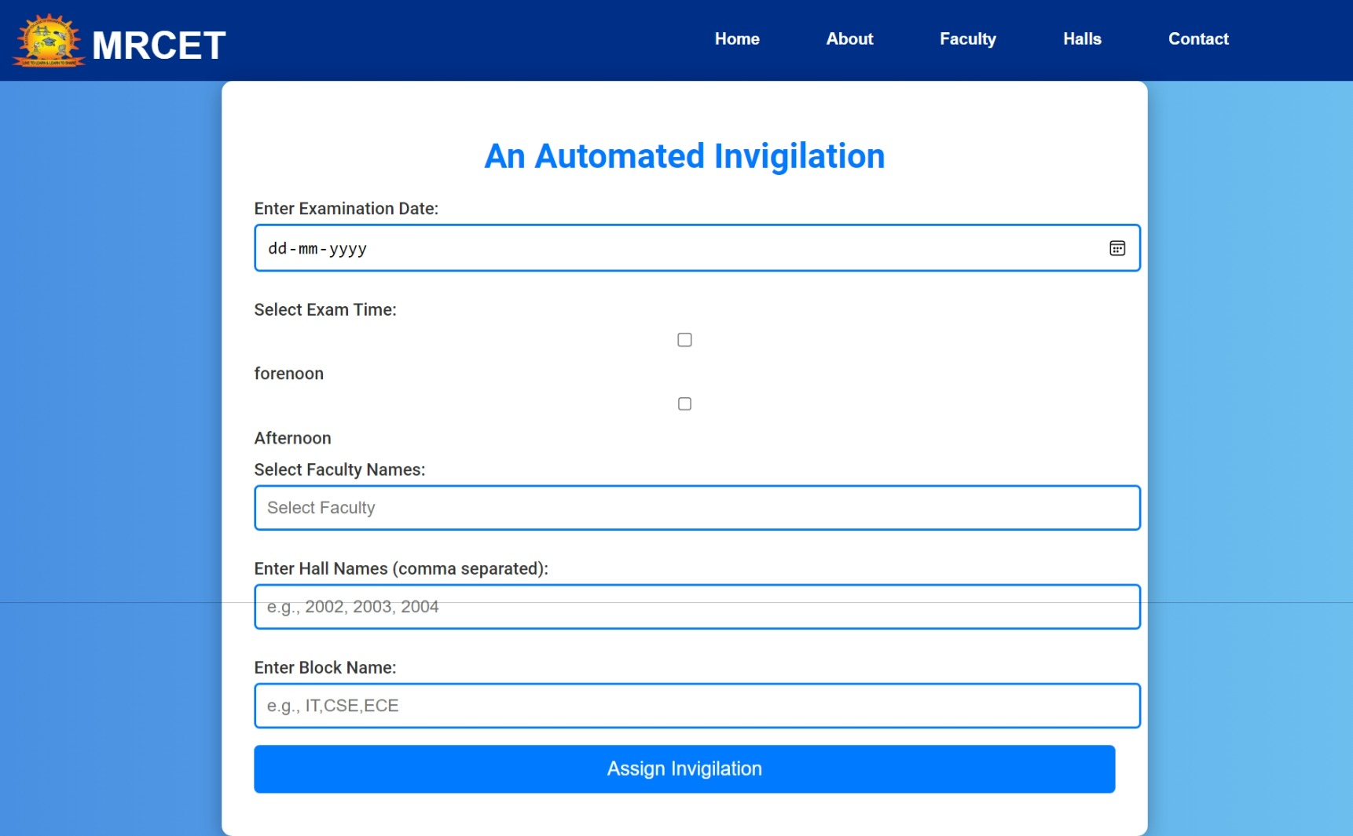

Slide 13
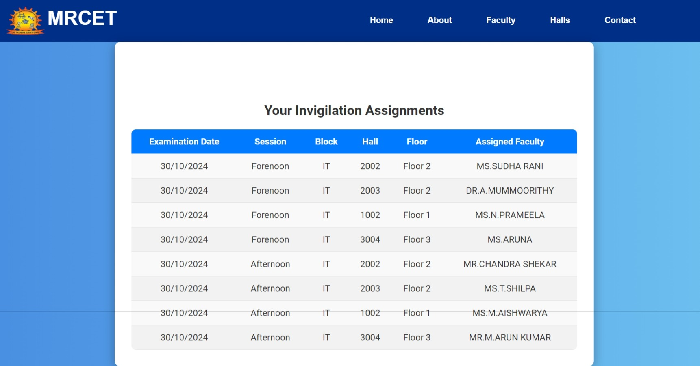

Slide 14

.

Slide 15
Conclusion
In conclusion, transitioning from a manual system to an Automated Invigilation Scheduler can significantly enhance the efficiency and effectiveness of exam management. By addressing the inherent challenges of manual scheduling such as time consumption, human error, and resource misallocation this automated solution streamlines processes, ensures adequate coverage, and improves communication among staff. Ultimately, adopting such technology not only alleviates administrative burdens but also upholds the integrity of the examination process, allowing institutions to focus on their core mission of providing quality education.

Slide 16
REFERENCES
https://www.crio.do/
https://chatgpt.com/
https://www.guvi.in/

